Slide 1
Diff eq ch 11

Slide 2
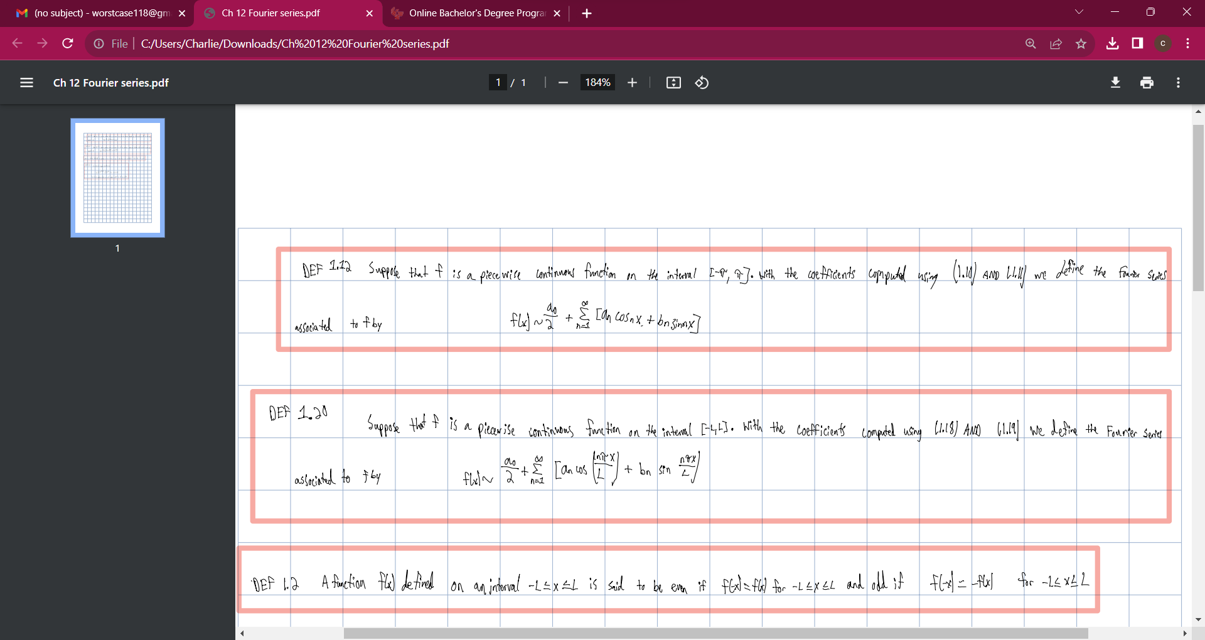

Slide 3
